Slide 1
Asset Pricing & CAPM
資產定價 ＆ 資本資產定價模型

Slide 2
OUTLINE
Asset Pricing
What is “Asset Pricing”?
Mainstream Asset Pricing Model
CAPM
Introduction of CAPM
Theoretical background of CAPM
CAPM
Summarize
Reference

Slide 3
Asset Pricing

Slide 4
Asset Pricing: What is “Asset Pricing” ?
Condition | Explanation
Cash Flow | Ex. Interest, Dividends, Rents
Discount Rate | Opportunity Cost (OC)
Risk and Reward (RR) | The balance between risks and rewards.
Market | Ex. Supply & Demand, Economic Environment, Investor sentiment

Slide 5
Asset Pricing: Mainstream Asset Pricing Model
Model | Explination
Discounted Cash Flow (DCF) | Cash Flow + Discount Rate
Relative Valuation | Similar Asset
Capital Asset Pricing Model (CAPM) | Risk and Reward

Slide 6
Introduction of CAPM

Slide 7
CAPM: Introduction
Introducing the concepts of systemic risk and unsystematic risk.
Quantitatively analyze the relationship between risk and reward.

Slide 8
CAPM: Systemic Risk & Nonsystemic Risk
Risk | Sphere | Expample | Risk Management
Systemic Risk | Entire market | Interest rate hike, interest rate cut | Hedging using financial derivatives
Nonsystemic Risk | Individual companies and industries | Company bankruptcy, product failure | Diversification

Slide 9
CAPM: Characteristic of Market Portfolio（市場投資組合）
Characristic | Explanation
Full Market Coverage | Contains all types of assets, and the allocation ratio is consistent with market capitalization.
Completely Decentralized | Eliminates all unsystematic risk.
Benchmark | Used as benchmarks against which to measure the individual assets.

Slide 10
Theoretical background of CAPM

Slide 11
CAPM: Efficient Market Hypothesis (EMH)
Form | Explanation
Weak | Investors cannot use past information to get reward.
Semi-Strong | Investors cannot use publicly available information to get reward.
Strong | Investors cannot use private information to get reward.

Slide 12
CAPM: Capital Market Line (CML) (from MPT)
(Risk-Free Asset + Market Portofolio)
Capital Market Line
（資本市場線）
Expect
Return
Individual Asset
Risk Free
Expect Risk

Slide 13
CAPM: Efficient Frontier (from MPT)
(The highest maximum return for a given risk.)
Expect
Return
Capital Market Line
Ideal Market Portfolio
（最理想組合）
Individual Asset
Risk Free
Efficient Frontier
（效率前緣）
Expect Risk

Slide 14
CAPM

Slide 15
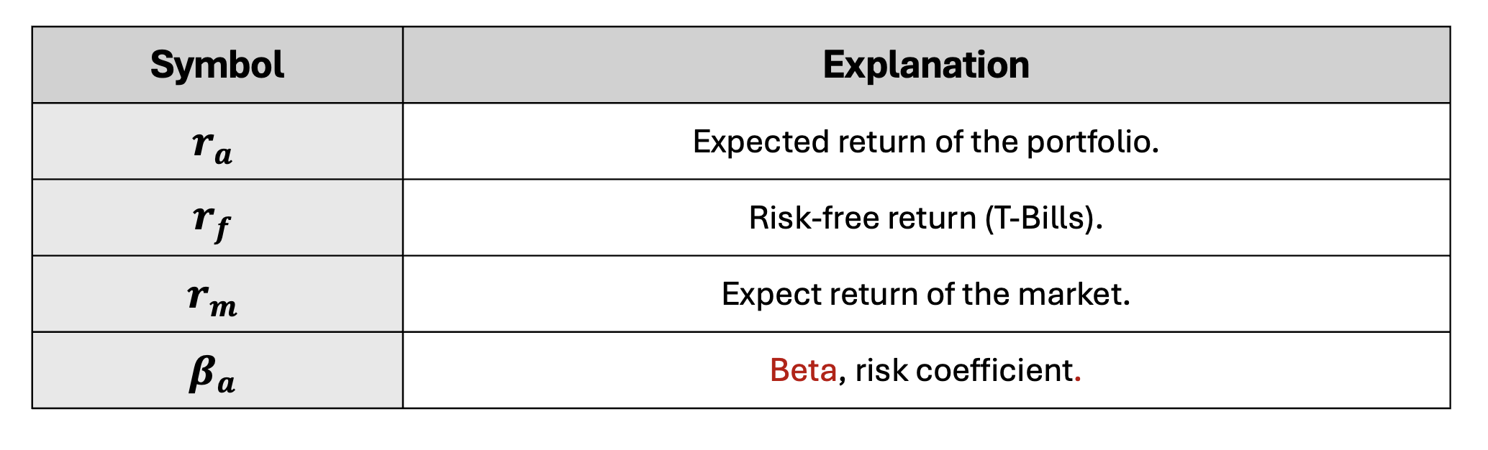
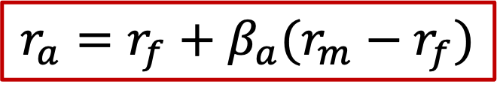
CAPM: CAPM Formula
$$r_{a}=r_{f}+β_{a}(r_{m}−r_{f})$$
$$⇒期望報酬率＝無風險資產報酬率＋風險係數×風險貼水$$

Slide 16
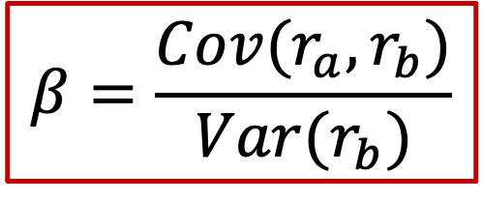

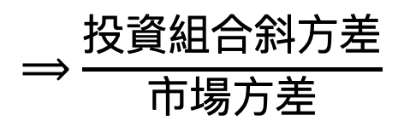
CAPM: β
$$β=\frac{Cov(r_{a},r_{b})}{Var(r_{b})}$$
$$⟹\frac{投資組合斜方差}{市場方差}$$
$$⟶投資組合相對於市場的波動$$
Beta = 1 | 波動與市場相同
Beta > 1 | 波動比市場大
Beta < 1 | 波動比市場小
Beta < 0 | 波動與市場相反

Slide 17
Summarize

Slide 18
Asset Pricing & CAPM: Summarize
Background Theory | EVM: Assume market is semi-strong. MPT: CML（資本市場線）、Efficient Frontier（效率前緣）
Risk | Systemic Risk: Entire market Nonsystemic Risk: Individual companies and industries
Formula | 期望報酬率 = 無風險資產報酬率 + 風險係數*風險貼水
Beta | 投資組合相較整體市場的波動率。

Slide 19
Asset Pricing & CAPM: Summarize
Advantages | 簡單易用的公式。 對風險和回報的量化。 適用於多種資產。 理論嚴謹。
Disadvantages | 過於理想：磨損、人性、資訊不對稱等。 β穩定性。 風險偏好的局限性。

Slide 20
Asset Pricing & CAPM: Reference
Corporate Finance Institute. (n.d.). What is CAPM - Formula, Explanation, Example, Calculate. Retrieved June 15, 2024, from https://corporatefinanceinstitute.com/resources/valuation/what-is-capm-formula/
Sak, M. (n.d.). Asset pricing. Retrieved June 15, 2024, from https://people.bath.ac.uk/mnsak/Research/Asset_pricing.pdf
Corporate Finance Institute. (n.d.). Efficient markets hypothesis. Retrieved June 15, 2024, from https://corporatefinanceinstitute.com/resources/career-map/sell-side/capital-markets/efficient-markets-hypothesis/
Corporate Finance Institute. (n.d.). Modern portfolio theory (MPT). Retrieved June 15, 2024, from https://corporatefinanceinstitute.com/resources/career-map/sell-side/capital-markets/modern-portfolio-theory-mpt/

